Slide 1

Personal Development Curriculum 2026 2027 at
Parkstone Primary School

Slide 2
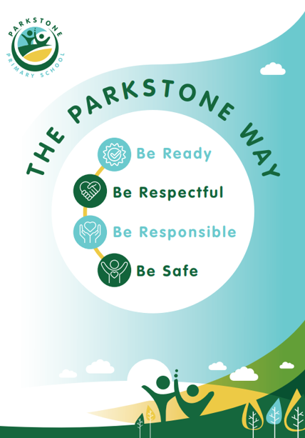
Our vision:
We aim to ensure that, over their time at Parkstone Primary, pupils receive a Personal Development curriculum that gives them the knowledge that they need to make decisions, to be resilient and to develop their character and personality. We provide these rich experiences in a coherently planned way – through our curriculum and extra curricular activities.
Through ‘The Parkstone Way’ we teach positive behaviours that are expected in school and within our families and community.
            Pupils leave Parkstone with the confidence to try new things and make mistakes, seeing the opportunity that lies with adversity. Our bespoke curriculum has been designed to get the best out of each and every learner.

Slide 3
Enrichment and Cultural Capital
Opportunities provided in or out of school that enhance the taught curriculum and promote social mobility through a wider understanding and appreciation of community.
This exists beyond the classroom but can support or be supported by academic curriculum.
RSE and PSHE
Timetabled curriculum-based lessons covering appropriate topics from 5 key areas: Personal safety, Relationships, The Law, Mental Health and Lifestyle.
Educating our pupils to safe in the world.
Our Drivers:
Character
The development of cognitive and moral qualities that contribute to a persons’ individuality and makes them different from others.
Careers
Raising awareness of and preparing pupils for their next stage of education, training or employment.

Slide 4

At Parkstone Primary School, Personal Development is about how well children are supported to become confident, independent, respectful, healthy and active members of their community. In EYFS this is woven through daily practice, relationships, routines, behaviour expectations, wellbeing support and opportunities to develop character.
Personal Development in EYFS
Area of Personal Development | What We Do in EYFS | Impact on Children
Personal, Social and Emotional Development (PSED) | Daily circle times, staff/pupil relationships, emotional coaching, feelings discussions, friendship support and restorative conversations. | Children develop confidence, resilience, self-regulation and positive relationships.
Building Independence | Self-selection of play based learning, self-care routines, choosing resources, tidying up, managing belongings and selecting challenges independently. | Children become increasingly independent and take responsibility for themselves and their learning.
Managing Feelings and Behaviour | Visual supports, behaviour modelling, clear routines, zones of regulation, social stories and positive reinforcement. | Children understand expectations, regulate emotions and make positive choices.
Communication and Relationships | Partner work, turn-taking games, collaborative play and supported conversations. | Children learn to listen, communicate effectively and work with others.
Physical Health and Wellbeing | Daily outdoor play, gross motor provision, fine motor activities, healthy eating discussions and rest opportunities where needed. | Children understand healthy lifestyles and develop physical wellbeing.
Mental Health and Emotional Wellbeing | Trusted adults, nurture support, wellbeing check-ins, calm spaces, emotional literacy activities and trauma informed nurture activities. | Children feel safe, valued and able to express their emotions appropriately.

Slide 5
Personal Development in EYFS (continued)
Area of Personal Development | What We Do in EYFS | Impact on Children
Understanding Diversity and Inclusion | Diverse books, celebrations of different cultures, learning about families, British Values and valuing individual differences. | Children develop respect, tolerance and understanding of others.
British Values | Democracy through voting, class rules, sharing, taking turns, respecting others and learning right from wrong. | Children begin to understand life in modern Britain and become responsible citizens.
Community and Wider Experiences | Visitors to school, educational visits, community walks, links with local services and participation in school events. | Children develop awareness of the wider world and their place within it.
Character Development | Encouraging perseverance, problem-solving, determination, teamwork and celebrating effort as well as achievement. | Children develop resilience and a positive attitude towards challenge.
Online Safety | Age-appropriate discussions about technology, using devices safely with adult support and understanding trusted adults. | Children begin to understand how to stay safe online.
Transition Support | Home visits, stay-and-play sessions, transition books (when needed), meetings with families and links with, feeder nurseries and Year 1. | Children feel secure and confident during periods of change.
Attendance and Belonging | Strong home-school relationships, celebrating attendance and ensuring every child feels included. | Children develop a sense of belonging and engagement with school life.
SEND and Individual Needs | Individual provision, visual timetables, targeted interventions and close partnership with families and outside agencies. | All children are supported to achieve their potential and participate fully.

Slide 6
Personal development is embedded throughout our EYFS curriculum and daily practice. We prioritise children's emotional wellbeing, independence, resilience and social skills. Through high-quality relationships, carefully planned experiences and strong partnerships with families, children develop confidence, respect for others and the skills needed to become active, healthy and successful learners. Personal development is not taught as a standalone subject but is woven through all aspects of our provision and curriculum.
Evidence | Examples
Learning Environment | Visual timetables, feelings displays, class rules, diverse resources and books.
Children's Behaviour | Positive relationships, cooperation, independence and engagement.
Planning and Provision | PSED opportunities, British Values, community experiences and wellbeing activities.
Pupil Voice | Children discussing feelings, friendships, choices and school experiences.
Parental Partnerships | Parent workshops, communication systems and shared learning.
SEND Practice | Individual support plans, visual aids and personalised provision.

Slide 7
Enrichment and Cultural Capital
Our enrichment and cultural capital offer is carefully planned through our safeguarding calendar and wider curriculum. Pupils benefit from a wide range of experiences including regular school trips, leadership roles, pupil voice, sporting opportunities, visitors and community links. These experiences develop pupils’ knowledge of the wider world, celebrate diversity, promote British Values and build the social and cultural understanding they need to succeed.
What does this look like?
Enrichment:
School Trips
Every class having at least one trip per term provides rich, experiential learning beyond the classroom.
Clubs
Pupil voice shaping free clubs ensures access, choice and engagement for all pupils.
Sports Coaches
Tigers Trust and Hull KR Specialist coaching, lunchtime and after‑school clubs extend physical education opportunities.
Hull Active Schools (Gold Award)
Demonstrates sustained, high‑quality enrichment through sport and physical activity.
Whole School Events
House events, themed days and shared experiences enrich school life and promote belonging.
Visitors
Assemblies and workshops from external visitors widen pupils’ experiences and aspirations.
Ambassadors: Wellbeing, Reading, Attendance
Leadership roles enrich pupils’ personal development and responsibility.
Parkstone Jobs:
We offer a range of jobs for pupils to apply for including Lunchtime Supervisors and Distribution managers.
Cultural Capital
British Values
Carefully planned through the PSHE curriculum and embedded via The Parkstone Way.
PSHE & Religion and Worldviews Curriculum
Explicit curriculum drivers for understanding communities, diversity and societal norms.
Celebrations (Cultural & Religious)
Recognition and celebration of cultures within the school community builds inclusivity and awareness.
Learning Attitudes
Pupil‑designed learning behaviours help children understand expectations, independence and resilience.
School Council
Democratic participation, pupil voice and assembly leadership reflect key cultural capital skills.
Safeguarding Calendar
Structured exposure to themes such as online safety, respect, equality and British Values.

Slide 8
Character
The development of cognitive and moral qualities that contribute to a persons’ individuality and makes them different from others.
What does this look like?
1. Encouraging Children to Think About Belonging, Identity & What Makes Them Unique:
Children learn that families are different, that we all belong to groups, and that belonging helps shape who we are. EYFS and KS1 lessons ask children to explore their own families, culture and experiences, helping them articulate what makes them “them.” R.E and World Views themes such as “Belonging” (Unit 1.1) explicitly develop understanding of identity, personal values, and community ties.
2. Developing Personal Moral Understanding (Right, Wrong, Choice-Making)
KS1 RE (Unit 2.1: Lead Us Not Into Temptation) teaches how people understand right and wrong and how moral rules guide behaviour. Children learn that actions have consequences and explore moral stories (e.g., Good Samaritan), directly shaping moral reasoning. PSHE teaches pupils to reflect on behaviour, empathy, emotional regulation, and fairness, building strong moral judgement.
3. Teaching Critical & Philosophical Thinking
Religion and World Views explores “Big Questions” (e.g., Who am I? What is the world? Why do bad things happen?) through the philosophy lens, encouraging reasoning, questioning and justification of viewpoints. Y2 Unit Questions, Questions??? has pupils discuss ultimate questions and explore different answers from religious and non‑religious worldviews. Children are encouraged to form opinions respectfully and understand that not all questions have simple answers.
4. Building Respect, Empathy & Appreciation of Differences
RE systematically exposes children to Christianity, Islam, Hinduism and Humanism, teaching respect and curiosity about diverse worldviews. PSHE covers respect, kindness, tolerance, respectful relationships, and challenging stereotypes throughout every year group. Lessons explicitly teach pupils that people celebrate differently, believe different things, live different lives and deserve equal respect.
5. 5. Fostering Social Responsibility & Understanding of Community
RE units such as “Communities” (Y4) and “Sacred Places” (Y3) explore identity, belonging, participation, and community values. PSHE develops understanding of rules, democracy, children's rights, charity, and the role of community helpers—linking children to wider society. Children analyse how their actions affect others and how communities support each other (e.g., food banks, local charities).

Slide 9
Character
The development of cognitive and moral qualities that contribute to a persons’ individuality and makes them different from others.
What does this look like?
6. Strengthening Emotional Intelligence and Self‑Awareness
EYFS and KS1 PSHE lessons focus heavily on naming feelings, emotional regulation, coping strategies, empathy, and resilience. Pupils are taught to reflect on emotions, identify their triggers, and practise strategies to manage them—an essential part of individuality. Growth mindset lessons help children understand identity as something that develops through effort and reflection.
7. Supporting Children to Understand Beliefs & Personal Values
RE explicitly covers how people express beliefs, make commitments, and follow values (e.g., Unit 5.1 Expressions, Unit 4.2 People Who Inspire Us). Children explore the values behind worship, rituals, festivals, moral choices and altruism, enabling them to reflect on their own values. Pupils learn how faith founders and inspirational people shape moral frameworks and personal ideals.
8. Developing Independent Thinking & Personal Decision-Making
PSHE lessons teach children to make safe, informed, independent decisions about friendships, safety, online behaviour and health. Children practise reasoning, weighing pros and cons, and evaluating influence and peer pressure (e.g., Y5 lesson: Influence & decision making). RE encourages children to evaluate beliefs, compare traditions and draw their own conclusions—key to developing individuality.
9. Providing Opportunities to Build Voice, Confidence & Personal Expression
Oracy opportunities across RE and PSHE (debate, hot seating, circle discussions, presentations) enable pupils to articulate their perspectives. Children express themselves through art, discussion, drama and collaborative learning—key to forming individual identity.

Slide 10
Careers
Raising awareness of and preparing pupils for their next stage of education, training or employment.
What does this look like?
Early Careers Awareness Begins in EYFS
a) Occupations Unit – “Our Families / Occupations”
Children encounter real-world jobs (doctors, nurses, firefighters, police, teachers, paramedics, dentists, cleaners, soldiers, hospital staff) and meet visitors who talk about their roles. This provides early grounding in understanding that adults have different occupations.
b) Visitor Opportunities
The RE/World Views curriculum ensures inviting parents and community members to talk about their work, which links to identity, community roles and early exposure to work.
2. Careers Explicitly Taught in PSHE Across the School
(A) Careers Through Economic Wellbeing ModulesY1/2 – Understanding Money, Spending & Saving Children begin to understand why adults work, how money is used, and how people earn income. This lays the foundation for understanding that jobs are connected to earning and meeting needs.
Career Quest (L5): Exploring a Range of Jobs
Pupils examine a wide range of jobs and begin identifying personal interests and strengths that link to future occupations. They complete a “job card,” choosing careers that match their strengths, interests, and motivations.
Y5/6 – Careers, Qualifications & Skills Through Real‑Life Scenarios
Upper KS2 explore: How people budget, manage money, and plan financially. How safeguarding money connects with online work (e.g., online financial risks)Skills needed for different jobs through critical thinking tasks. Decision‑making and independence, important for future career pathways
Promoting High Aspirations by Challenging Stereotypes
a) Challenging Gender Stereotypes (Y1/2, Y3/4, Y5/6)
Children learn that jobs are not tied to gender, and that stereotypes discourage ambitions.
Examples:Y1/2 lesson on gender in careers (Expect Respect toolkit)
Y3/4 lessons on stereotypes, including disability, reinforcing that careers are open to allY5/6 deep dive into racial, religious and gender stereotypes. This widens pupils’ understanding of who can do what job, encouraging ambition
b) RE Unit – “Faith in Action” (Y5) Pupils study the jobs people do because of their values – including charity work, community support, teaching, healthcare, volunteering and activism. This develops understanding of purpose-driven careers.

Slide 11
RSE
Timetabled curriculum-based lessons covering appropriate topics from 5 key staffs: Personal safety, Relationships, The Law, Mental Health and Lifestyle.
Educating our pupils to be ‘Life-Smart’.
What does this look like?
The Five Life‑Smart Key Strands at Parkstone
Personal Safety
Pupils are taught how to keep themselves safe in real‑life contexts, age‑appropriately:
Physical safety: safe and unsafe touch, consent, PANTS rule, privacy and body autonomy
Safeguarding: trusted adults, how to seek help, emergency services and phone calls
Online safety: cyberbullying, age restrictions, safe sharing, digital footprints
Road and community safety: pedestrian skills, Bikeability, emergency response
Substance safety: medicines, tobacco, alcohol and drugs
First aid: bleeding, head injuries, basic life support (upper KS2)
Safety learning is revisited annually and deepened as pupils grow, ensuring confidence and independence.
2. Relationships
Relationships education is at the heart of the curriculum:
Healthy friendships and families
Managing conflict, bullying and peer pressure
Respect, consent and boundaries (including online relationships)
Stereotypes, discrimination and challenging unfair behaviour
Grief, loss and emotional support
Self‑respect and respect for others
Learning moves from recognising feelings in EYFS to negotiation, compromise and conflict resolution in upper KS2
3. The Law
Parkstone ensures pupils understand how rules and laws shape society:
British Values taught explicitly:
Rule of Law, Democracy, Mutual Respect, Tolerance, Individual Liberty
Understanding what happens when laws are broken
Role of the police, courts and justice system
Local and national democracy: school council, councillors, Parliament and MPs
Human rights and the UN Convention on the Rights of the Child
Discrimination, protected characteristics and equality
By Year 6, pupils can discuss why laws matter and consider the consequences of their absence.

Slide 12
PSHE and RSE
Timetabled curriculum-based lessons covering appropriate topics from 5 key staffs: Personal safety, Relationships, The Law, Mental Health and Lifestyle.
Educating our pupils to be ‘Life-Smart’.
4. Mental Health
Mental wellbeing is threaded throughout the curriculum:
Naming and managing emotions
Growth mindset and resilience
Responsibility for feelings and actions
Coping strategies and problem‑solving
Mental health awareness and reducing stigma
Knowing where and how to seek help
Pupils build emotional literacy from EYFS self‑regulation through to resilience toolkits and mental health discussions in KS2
5. Lifestyle
Healthy lifestyle choices are taught practically and progressively:
Healthy eating, dental hygiene and nutrition
Exercise, sleep and relaxation
Personal hygiene and immunisation
Environmental responsibility (recycling, caring for the world)
Money awareness: saving, spending, budgeting, online risks
Careers, aspirations and understanding strengths
This supports pupils to make informed, healthy choices that promote long‑term wellbeing.
How Learning Is Made Inclusive and Effective:
Strong oracy focus: circle time, debates, role play, partner talk, presentations and hot seating
SEND‑inclusive practice:
Visual supports and symbols
Multi‑sensory activities
Clear routines and repetition
Flexible ways to record understanding
Emotional check‑ins and adult scaffolding
Explicit progression: clearly identified prior learning and future learning in each unit

Slide 13

PSHE and RSE
Timetabled curriculum-based lessons covering appropriate topics from 5 key staffs: Personal safety, Relationships, The Law, Mental Health and Lifestyle.
Educating our pupils to be ‘Life-Smart’.
Parkstone, Police Education (Pol-Ed) supplements our Personal Development curriculum, helping pupils develop the knowledge, understanding and skills needed to stay safe, make responsible choices and become positive members of their community. Through age-appropriate lessons and discussions, pupils learn about topics such as personal safety, healthy relationships, online safety, bullying, peer pressure, anti-social behaviour and the law. Pol-Ed encourages children to develop resilience, respect for others and an understanding of their rights and responsibilities, preparing them to navigate challenges safely and confidently both in school and beyond.

Slide 14
Pupil Leadership roles at Parkstone
Pupil leadership is an integral party of Parkstone because it helps children develop the skills, attitudes and values they need to thrive both in school and in later life. When pupils are given meaningful leadership opportunities, they learn that their voice matters and that they can make a positive difference to their community.
Reading Ambassadors
School Councillors
Attendance Ambassadors
Lunchtime Supervisors
Distribution Managers
ICT monitors
Teaching Assistants
Tuck Shop managers

Slide 15

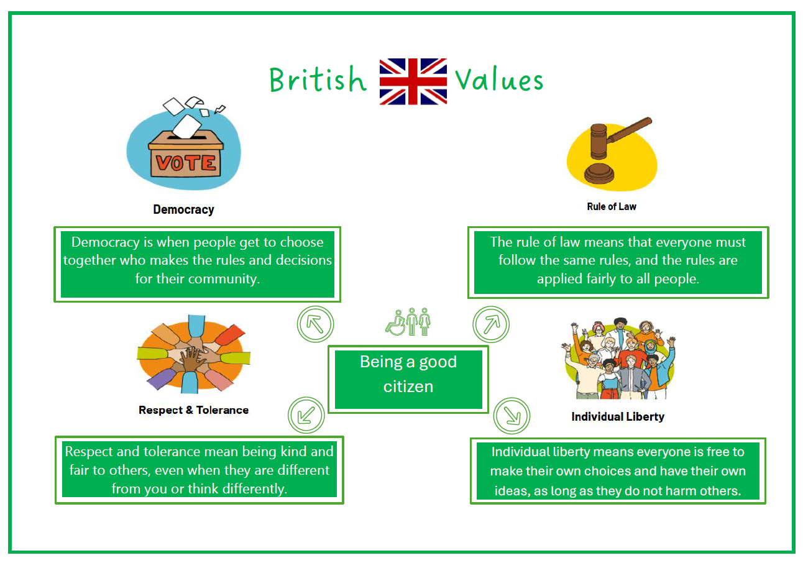
British Values

Slide 16
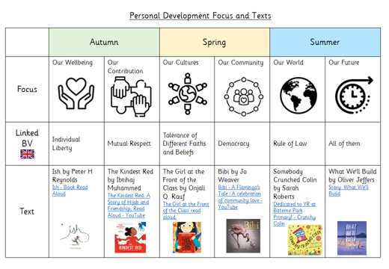
To further enhance our pupils’ understanding of British Values, we are enhancing our teaching of these from September 2026.
We will be introducing a focus for each half term which related to one of the British Values.

Slide 17


An example: Autumn 1
Ish by Peter H Reynolds
Our Wellbeing

Slide 18

Ish by Peter H Reynolds
Cycle | Y1/2 | Y3/4 | Y5/6
Cycle A | Ish Art Gallery A wellbeing‑centred art activity that reinforces the message that work doesn’t need to be “perfect” to be wonderful. | Ish‑Style Personal Motto Project A reflective wellbeing task where pupils craft a short personal motto that captures who they are ish — brave‑ish, kind‑ish, curious‑ish, determined‑ish. | Ish Mindset Journals A reflective wellbeing practice where pupils explore how “ish thinking” applies to real life — not just art.
Cycle B | Brave-ish Moments Circle A gentle PSHE activity that helps children recognise their own courage and celebrate small personal achievements. | Ish Problem‑Solvers Workshop A collaborative activity where pupils tackle small challenges using “ish thinking”—trying ideas, adapting, and valuing effort over perfection. | Ish Debates on Freedom of Expression A structured discussion exploring how Ish connects to the right to express yourself freely — a key aspect of individual liberty.

Slide 19
Ish by Peter H Reynolds
Cycle | Y1/2
Cycle A Ish Art Gallery | Core idea: Children create artwork that is “tree‑ish,” “house‑ish,” “flower‑ish,” etc., celebrating their own interpretations. Wellbeing link: Builds confidence, reduces perfectionism, and encourages pride in effort rather than outcome. Individual liberty link: Each child chooses what to draw and how to express it, reinforcing autonomy and creative freedom. How to run it: Read a short summary of Ish and discuss how Ramon learns that his drawings don’t need to be perfect to be meaningful. Give children a choice of materials (crayons, paint, collage). Invite them to create something “‑ish” and label it themselves. Display all pieces in an “Ish Gallery” to show that every style is valued. Extension: Add a reflection moment where children share how it felt to make something without worrying about it being “right.”
Cycle B Brave-ish Moments Circle | Core idea: Children share a moment when they tried something new, even if it didn’t go perfectly — a “brave‑ish” moment. Wellbeing link: Builds emotional resilience, self‑esteem, and a growth mindset. Individual liberty link: Children choose what to share and how much to say, reinforcing their right to express themselves in their own way. How to run it: Sit in a circle and remind pupils that everyone’s experiences matter. Model a “brave‑ish” moment (e.g., “I tried a new food. I didn’t love it, but I’m glad I tried”). Invite children to share if they want to — no pressure. Celebrate each contribution with warm, specific praise. Extension: Create a class “Brave‑Ish Book” where children draw or write about their moments over time.

Slide 20
Enrichment - 2025 – 2026 Autumn term
Autumn term 2026 2027
Autumn term 2026 – 2027
Job available for pupils
Hall monitor
Distribution manager
Tuck Shop managers
IT monitor
Teaching Assistants

Slide 21
Enrichment - 2026 – 2027 Spring term
Spring term 2026 – 2027
Job available for pupils

Slide 22
Enrichment - 2025 – 2026 Summer term
Summer term 2026 – 2027
Summer term 2026 – 2027
Job available for pupils

Slide 23
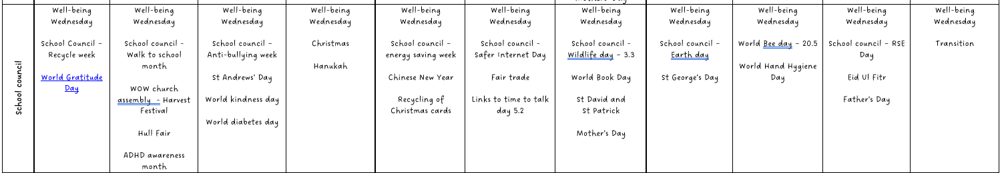
Our School Council: our school council meet weekly with Mrs Collins and follow a structured programme of meaningful activities:

Slide 24

All of what the children do is linked to The Parkstone Way:

Slide 25
Policy links
Behaviour curriculum
RSHE policy
Attendance policy
Anti-bullying policy
British Values policy

