Slide 1

Relationships, Sex and Health Education (RSHE) 2026
Information for Parents & Carers
Summer 2026

Slide 2
Purpose of Today
Explain the key changes in the new RSHE 2026 guidance
Show how our Kapow Primary curriculum aligns with the new expectations
Share our updated school RSHE policy
Give you space to ask questions and share feedback

Slide 3
What is RSHE?
Relationships, Sex and Health Education
A statutory part of the curriculum
Covers relationships, health, personal safety, and age‑appropriate sex education
Designed to help children stay safe, healthy, and confident
Taught sensitively and in partnership with parents

Slide 4
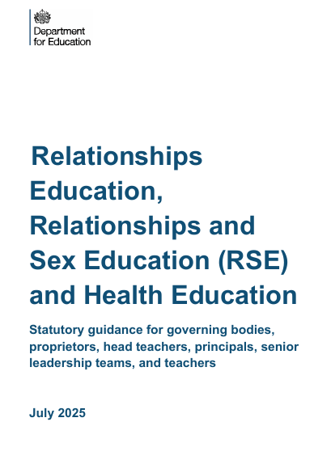
The New RSHE Guidance
The 2019 guidance has been replaced – Implementation required by Sept 2026.
Why the Guidance Has Changed
Responds to children’s real experiences
Increased online risks and digital pressures
National safeguarding priorities
Need for clearer expectations for schools
Greater consistency across settings

Slide 5
What has changed in the new 2026 guidance?
Added personal safety strand- roads, water, rail safety.
Updated content on online safety, including harmful content and AI
Clearer expectations around age‑appropriateness
Stronger emphasis on biological facts including teaching correct vocab for body parts
More explicit guidance on parental rights and transparency
Reinforced safeguarding expectations

Slide 6
What we must teach (statutory)
⭐ Relationships Education
Families
Friendships
Respect & kindness
Staying safe
Online behaviour
💚 Health Education
Mental wellbeing
Internet safety
Healthy bodies & habits
Hygiene & illness prevention
Basic first aid
Puberty
🔬 Science Curriculum
Life cycles
Reproduction in plants & animals
Human biology

Slide 7
Our Approach at Parkstone
We follow the Kapow Primary RSHE curriculum
Lessons are:
  Structured and age‑appropriate
  Evidence‑based
  Designed by specialists
Teachers receive training and support
Parents can view lesson content on request

Slide 8
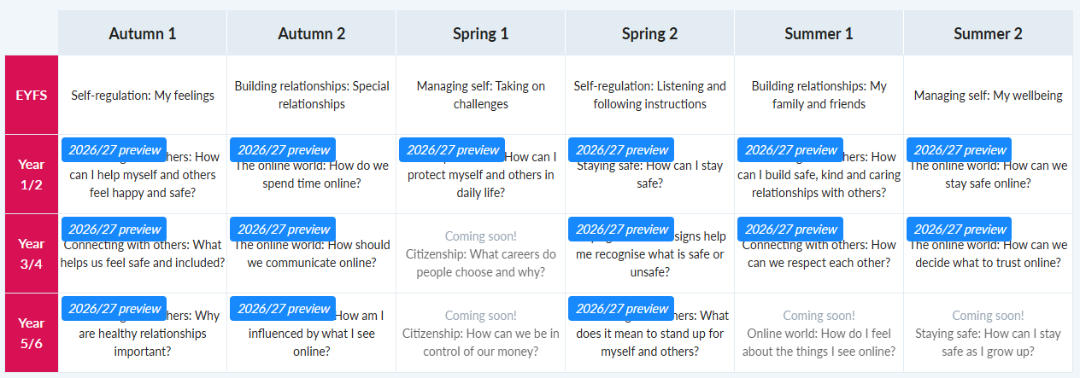
Overview of Kapow 26/27
The Kapow curriculum is being updated to be fully compliant with the new guidance

Slide 9
How Kapow Meets the New Guidance
Fully aligned with RSHE 2026 statutory requirements
Clear progression from EYFS to Year 6
Focus on facts, safeguarding, and healthy relationships
Transparent resources — parents can see everything
Built‑in assessment to track understanding

Slide 10
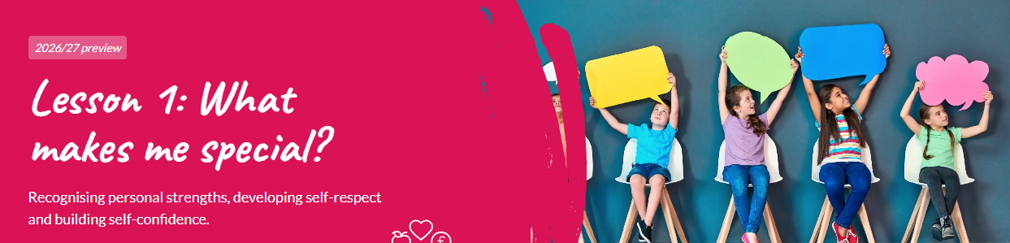
Example Lesson (KS1)

Slide 11
Safeguarding & Wellbeing
RSHE is a key part of safeguarding
Helps children recognise unsafe situations
Builds confidence to speak up
Supports mental health and emotional wellbeing

Slide 12
How we teach sensitive topics
Always age‑appropriate. Content is carefully sequenced so children only learn what is suitable for their age.
Always factual.
Always respectful.
Children encouraged to speak to trusted adults.
Questions handled sensitively and appropriately.
If a question is not suitable for the whole class, teachers will follow up individually or signpost to parents.

Slide 13
Body parts and the correct terminology
Puberty and body changes: physical and emotional changes
Personal hygiene
Reproduction in plants and animals (science)
Human conception (Year 6)
Respecting personal boundaries/ consent
Understanding private body parts and the concept of “private means private”
How to seek help if something worries them
Online safety
Families and relationships
Mental heath and emotional wellbeing
Drugs, alcohol and tobacco (health)

Slide 14
Teaching Correct Terminology
(Statutory)
Schools must teach the proper names for body parts, including genitals.
Supports safeguarding and clear communication
Taught in a calm, factual, age‑appropriate way
Euphemisms should not replace correct terms
Helps children understand privacy, boundaries, and how to seek help
This is not part of sex education it is health education.

Slide 15
Sex Education
Non statutory but many schools choose to teach it in Year 6.
In primary school, sex education is very limited and biological.
It focuses on how babies are conceived and born, taught factually and sensitively.
It is not about sexual behaviour, pleasure, or anything inappropriate for children.
Is taught alongside professionals. The nursing team come in to work with the children and teachers.

Slide 16
Why do we teach it?
Children benefit from accurate, factual information rather than myths or playground talk.
It helps them understand their bodies, puberty, and how life begins.
It supports safeguarding — children who understand their bodies are better able to recognise unsafe situations and seek help.

Slide 17
Parental rights
Parents cannot withdraw children from Relationships or Health Education
Parents can withdraw from non‑statutory sex education (Year 6 only) and should request a meeting with the head to discuss this.
We will always:
  Inform you before sensitive content.
  Share resources on request.
  Listen to your concerns- please ask!

Slide 18
Personal Development at Parkstone

Slide 19








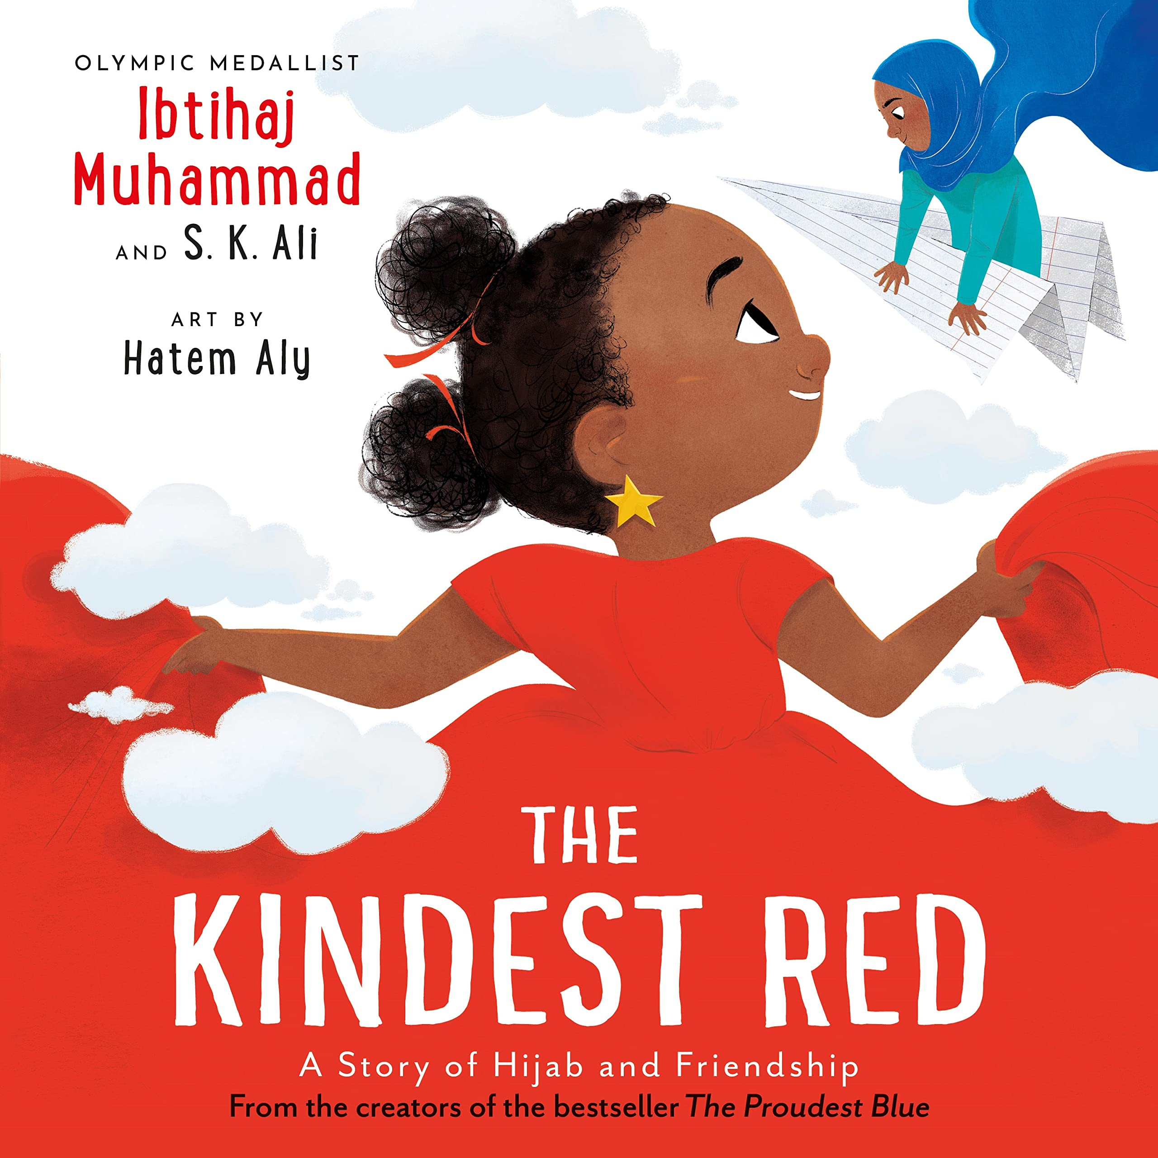
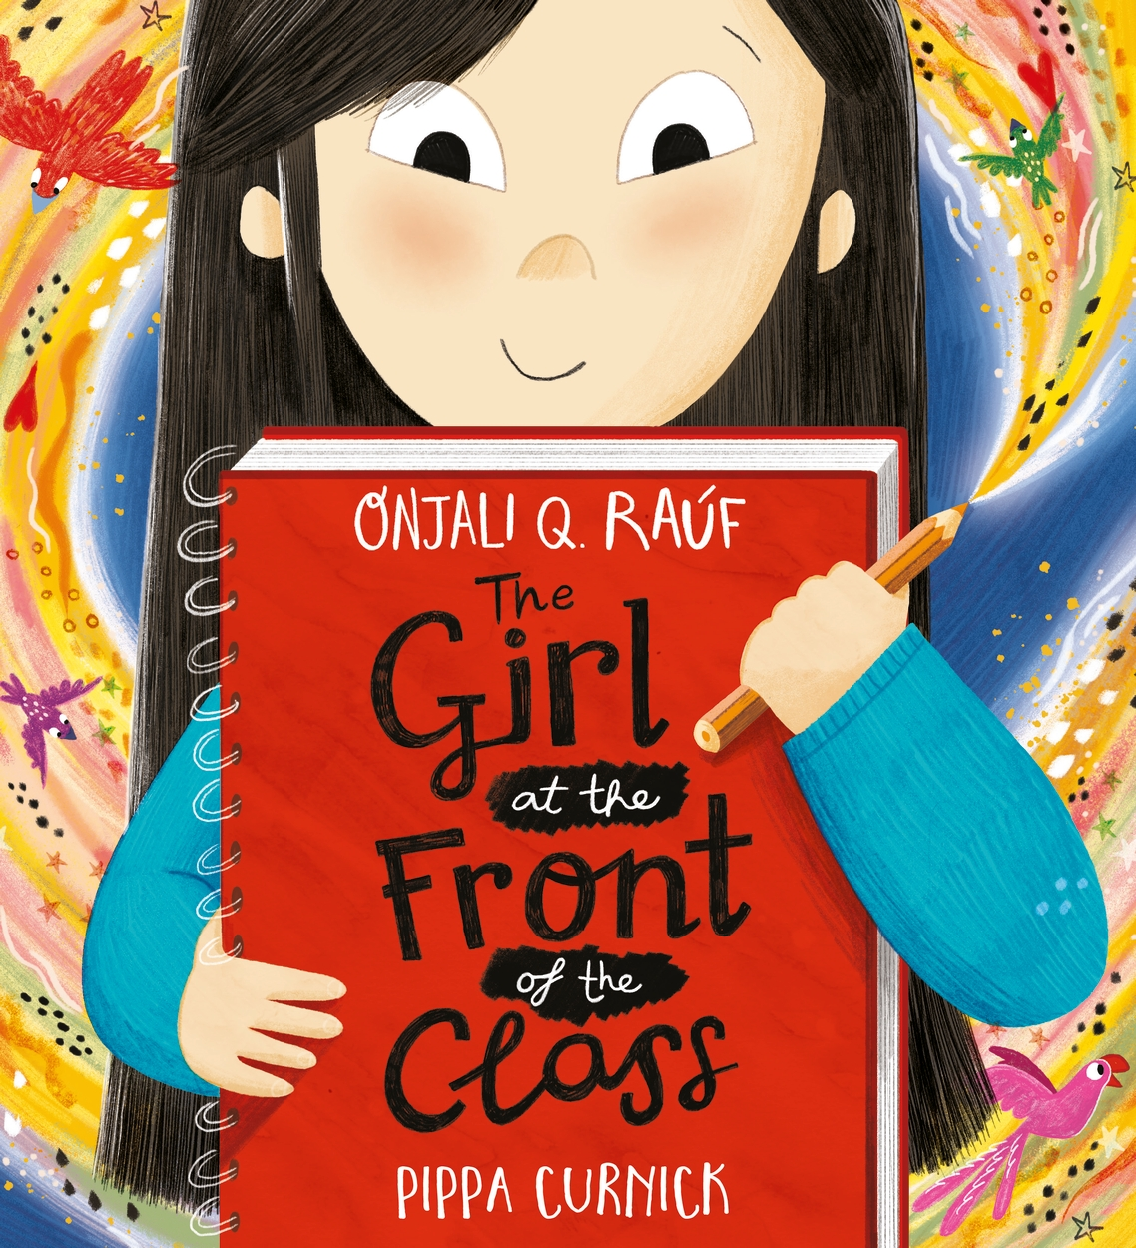



Personal Development Curriculum - Focus and Texts
 | Autumn |  | Spring |  | Summer
Focus | Our Wellbeing | Our Contribution | Our Cultures | Our Community | Our World | Our Future
Linked BV | Individual Liberty | Mutual Respect | Tolerance of Different Faiths and Beliefs | Democracy | Rule of Law | All of them
Text | Ish by Peter H Reynolds Ish - Book Read Aloud | The Kindest Red by Ibtihaj Muhammed The Kindest Red: A Story of Hijab and Friendship; Read Aloud - YouTube | The Girl at the Front of the Class by Onjali Q. Rauf The Girl at the Front of the Class read aloud. | Bibi by Jo Weaver Bibi - A Flamingo's Tale | A celebration of community love - YouTube | Somebody Crunched Colin by Sarah Roberts Dedicated to YR at Bitterne Park Primary! - Crunchy Colin | What We’ll Build by Oliver Jeffers Story: What We'll Build

Slide 20
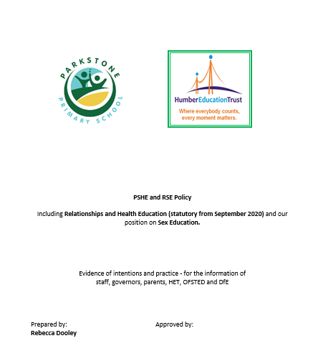
Our New Policy – Parent’s views

Slide 21
Thank you!
Thank you for supporting our school and helping us keep children safe, healthy, and confident.

