Slide 1
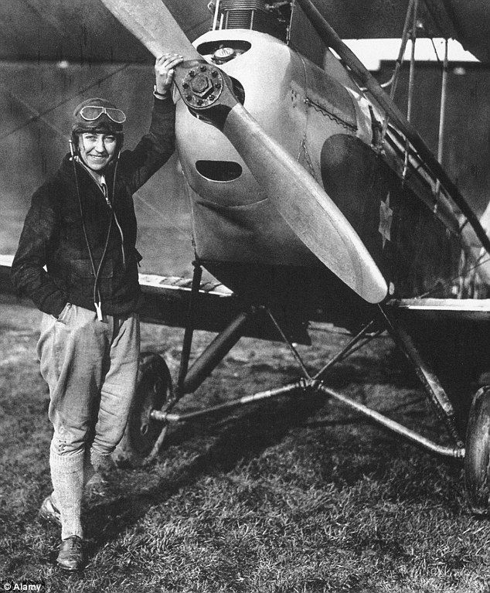
Maths
Place value including:
Counting in 2s, 5s, 10s and 3s
Count objects to 100
Represent numbers to 100
Compare and order numbers to 100
Addition and Subtraction including:
Bonds to 20
Bonds to 100
Add and subtract 1s and 10s
Year 2 – Autumn
Our topic for the Autumn Term is:
Amy Johnson 1903 - 1941
English
Reading
Read Write Inc will be used to teach phonics in small groups until children are fluent readers.
The Day the Crayons Quit by Oliver Jeffers will be the focus text in our English lessons. We will:
Make predictions
Retrieve information
Make simple inferences
Writing
I can segment spoken words into phonemes and represent these by graphemes
To use spacing between words that reflect the letter size
To demarcate most sentences in writing with capital letters and full stops.
As Scientists we will:
Describe which animals live in which habitats and why.
Understand the basic needs of living things.
Begin to understand how animals and plants obtain food.
As Geographers we will begin to learn about our local area through the unit ‘Where Am I?’
Know the names of the four countries that make up the UK
Begin to use maps for a purpose
Compare and contrast features using aerial photographs and plan perspectives to recognise landmarks and basic human and physical features
Begin to understand and add symbols to maps
In PSHE we will focus on ‘Being Me in my World’ and ‘Celebrating Differences’, learning to:
Explore my hopes and fears
Understand how assumptions based on gender can affect attitudes and behaviour
Understand that it is ok to be different from other people and to be friends with them.
As Artists and Designers, we will:
In Art, we will be using charcoal to learn how to create different lines and effects.
We will be using our learning to create an observational drawing.
In DT, we will use sliders and levers to create a moving storyboard to retell Amy Johnson’s flight.
As Historians we will explore the questions:
Who was Amy Johnson?
What did she do that was so extraordinary and when?
Sequence the events of her famous flight to Australia.
In Music we will focus on pulse and rhythm.
We will playing music and listening to music. We will be singing and taking part in a performance.
In World Views and Religion we will focus on the topic ‘Lead us not into temptation’ including:
Exploring the concept of temptation and how people choose between right and wrong. The faiths we study are:
Christianity
Islam
In Computing we will focus on online safety to answer these questions:
What does online mean and who should I speak to?
How do I login safely and keep information private?
We will also learn to:
Use a key board and mouse.
In PE, we will develop different ways to move at speed and begin to understand what being agile means while playing games.

